Slide 1
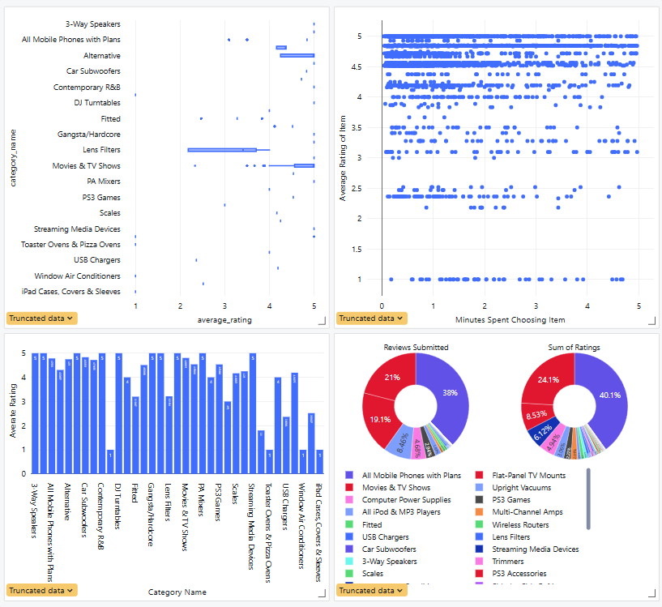
Best Buy Mobile Web Site Hackathon
A Hard Lesson in Data Cleaning
Juan Jose Diaz, and Norge Peña Perez(Mentor)
Miami Dade College, Kendall Campus, Miami, FL
Introduction
Conclusion
The intention of this project is to analyze the data provided by the Best Buy Mobile Hackathon to predict the category/SKU based on a query presented by a user. My intentions were to create a model to predict the category, but I soon realized that this was an impossible task with the tools I had at my disposal. There was over a million categories present in the data, and even more SKUs so reduction of cardinality was extremely difficult. I tried to cluster the data to reduce the size of the dependent variable, but to cluster I needed power to run through the data which I didn’t have. I also needed to overcome other elements such as difficulties in cleaning the data, and generating more attributes that are to be engineered to improve an eventual model. Overall, the process did teach me a lot of hard lessons which I will take with me on upcoming projects.
In conclusion the visualization is a representative sample, but you can see the sample yielded faster clicks depending on rating. This leads me to believe the higher the satisfaction of the product the faster someone is likely to choose it. This is important information when creating a model for prediction as we can train the model in speed of click, and average rating among other attributes we have yet to discover. I can see there is high variation of ratings in categories like lens filters using a box plot and see some work needing to be done on tv wall mount rating. The wall mounts seem to have high engagement, but lower rating than expected. If I had the capabilities to create a machine learning model to predict a category/SKU depending on some key factors, I would do so, but my attempts to create one have failed.
Materials
Results
The materials provided to me by the Hackathon was a python file to attain popular SKU, a csv containing popular SKU, a csv containing test data, a csv containing train data, and a zip file containing a couple of files. The files extracted include in the zip file will be explained below.
“Product_Data” directory:
categories 3MB
An XML File containing all products
products 8.2GB
Multiple XML files containing product data
reviews 153MB
Multiple files containing product review data
Methodology
My methodology starts with downloading the pertinent files from the Kaggle hackathon website and doing discovery on the files. Unzipping files was needed so I completed the unzip. I soon noticed that the files contained had an extension of .xml. This was something unfamiliar to me as we have been dealing with Xcel or CSV files. I then investigated means to convert the files within each folder to be more workable, and eventually joined them within a consolidated file. My attempts were slow, but I then realized that I could leverage the tools provided to me in the year 2024. The tool I'm speaking of is ChatGPT, and although staying away to force myself to understand content of the degree, this was a perfect situation to start using it. Through many iterations I correctly converted all files within all the directories to csv which then led to a consolidation of all the csv files within each folder. I then uploaded these files to the file store where I worked to clean and visualize my intended results.

